Slide 1
Unlocking Security: The Power of Password Managers and Generators

Slide 2
UNLOCKING SECURITY
Members:
Md. Aqleem Aviral Nikhil Priyanshi

Slide 3


UNLOCKING SECURITY
In a world where loom large,
understanding the importance of
and is essential. This presentation will explore how these tools can safeguard your , simplify your online experiences, and unlock a new level of
.

Slide 4



WHAT IS A PASSWORD MANAGER?
A
your
is a tool that securely stores and manages
.It helps you create strong, unique passwords for
each of your accounts, ensuring that your remains protected against unauthorized access.

Slide 5
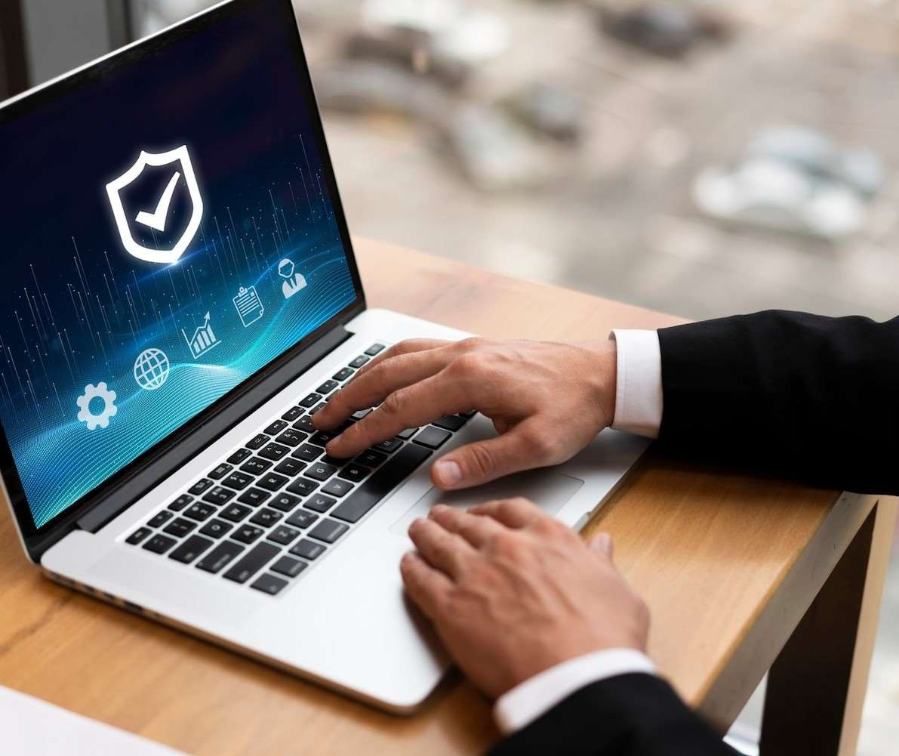







Using a offers
numerous benefits, including
BENEFITS OF USING PASSWORD MANAGERS
, convenience of access, and the ability to generate complex passwords.
This means less time worrying
about forgetting passwords and more time enjoying your
.

Slide 6
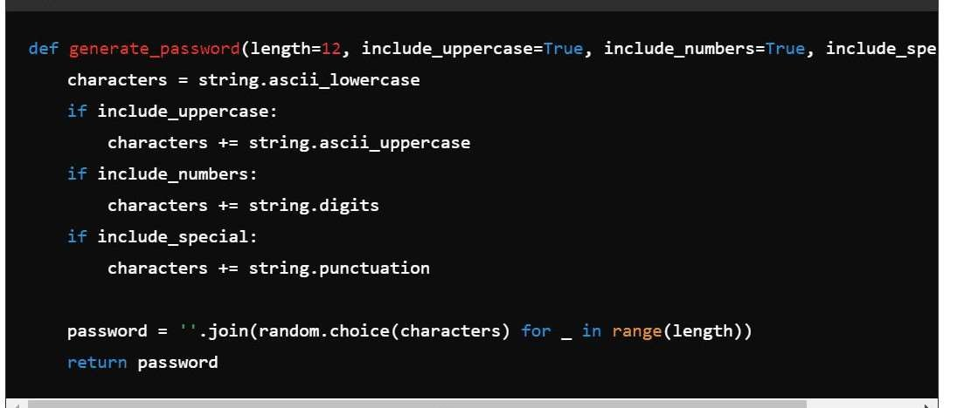
The generate_password function uses Python's random and string modules to create secure passwords tailored to the user's needs."

Slide 7
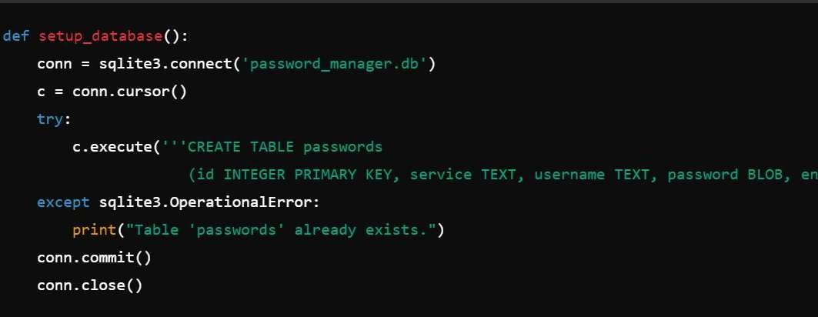
The setup_database function initializes the database, creating a table to store the service name, username, encrypted password, and the encryption type used.

Slide 8

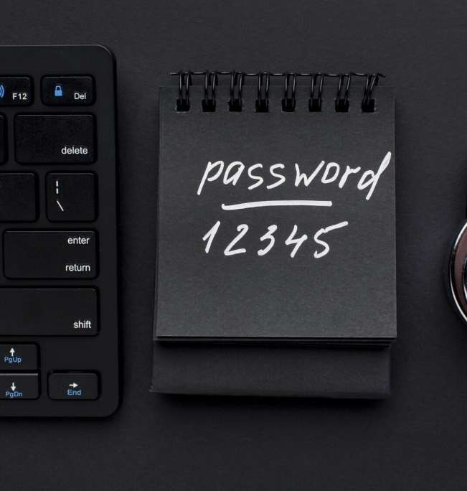


THE ROLE OF PASSWORD GENERATORS
create strong, random passwords that are diffcult for hackers to guess. By using these tools, you can ensure that your accounts are protected with
, reducing
the risk of .

Slide 9
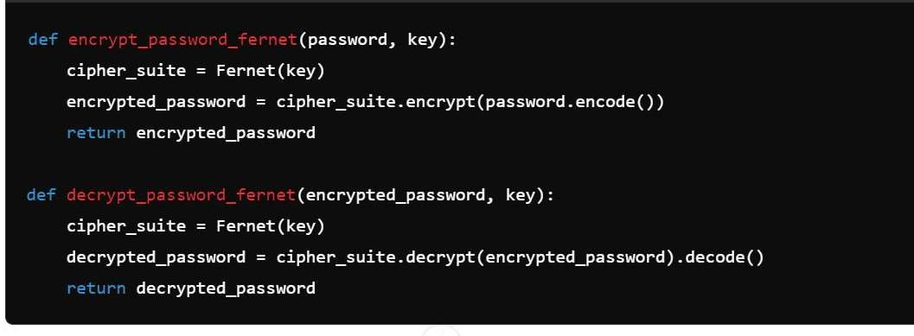
Symmetric Encryption using Fernet Key Generation and Management Encryption and Decryption Process

Slide 10
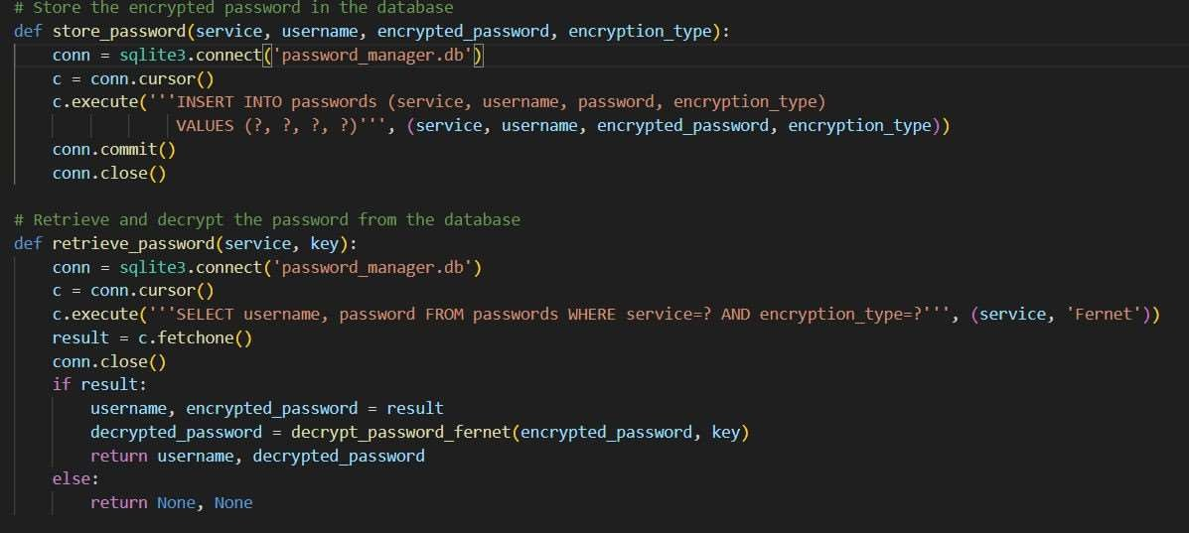
Storing encrypted passwords in the database Retrieving and decrypting passwords securely

Slide 11
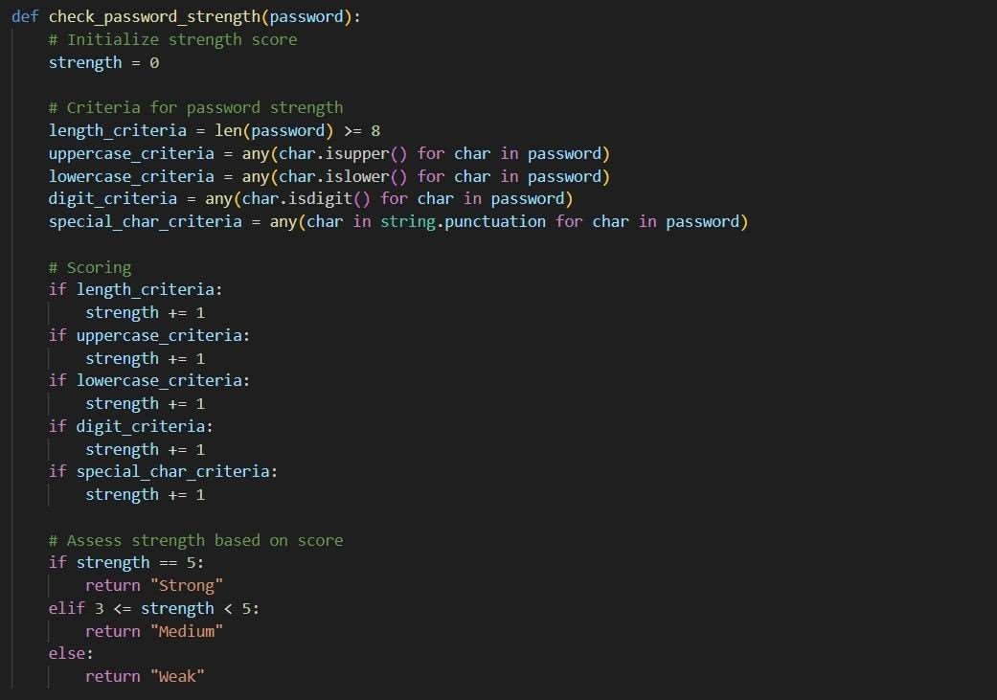
Add a body text

Slide 12
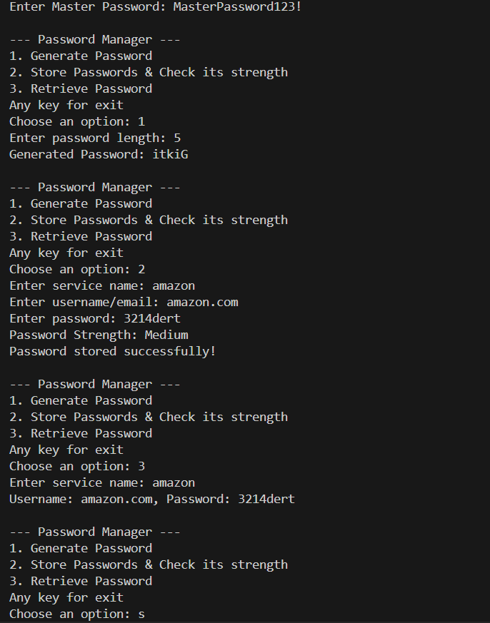
OUTPUT TERMIINAL

Slide 13
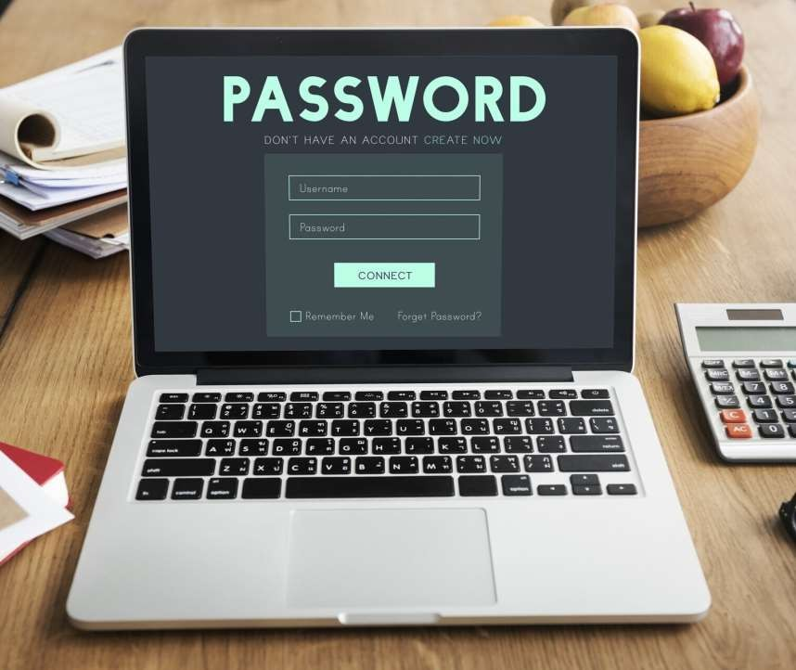




HOW PASSWORD MANAGERS WORK
encrypt your password database, requiring a
for
access. This means that even if someone gains access to your stored passwords, they cannot view them without the
.

Slide 14



CHOOSING THE RIGHT PASSWORD MANAGER
When selecting a , consider factors like
, user interface, compatibility with devices, and cost. Look for options that offer and
for enhanced protection.

Slide 15


COMMON MISCONCEPTIONS
Many users believe that
are unnecessary or insecure. In reality, they provide a than most
individuals can achieve on their own, making them a for anyone concerned about online safety.

Slide 16




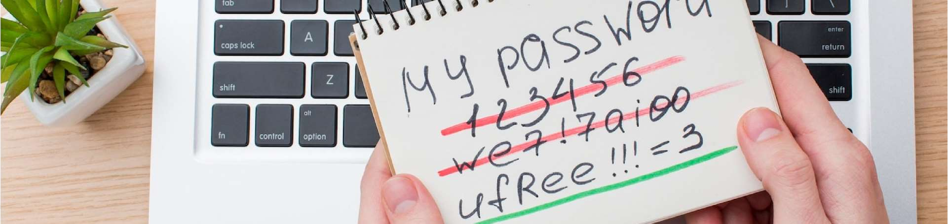
INTEGRATING PASSWORD MANAGERS
Integrating a into your daily routine can streamline your online experience. It can automatically fill in passwords, save new credentials, and even your existing passwords for strength and security.

Slide 17
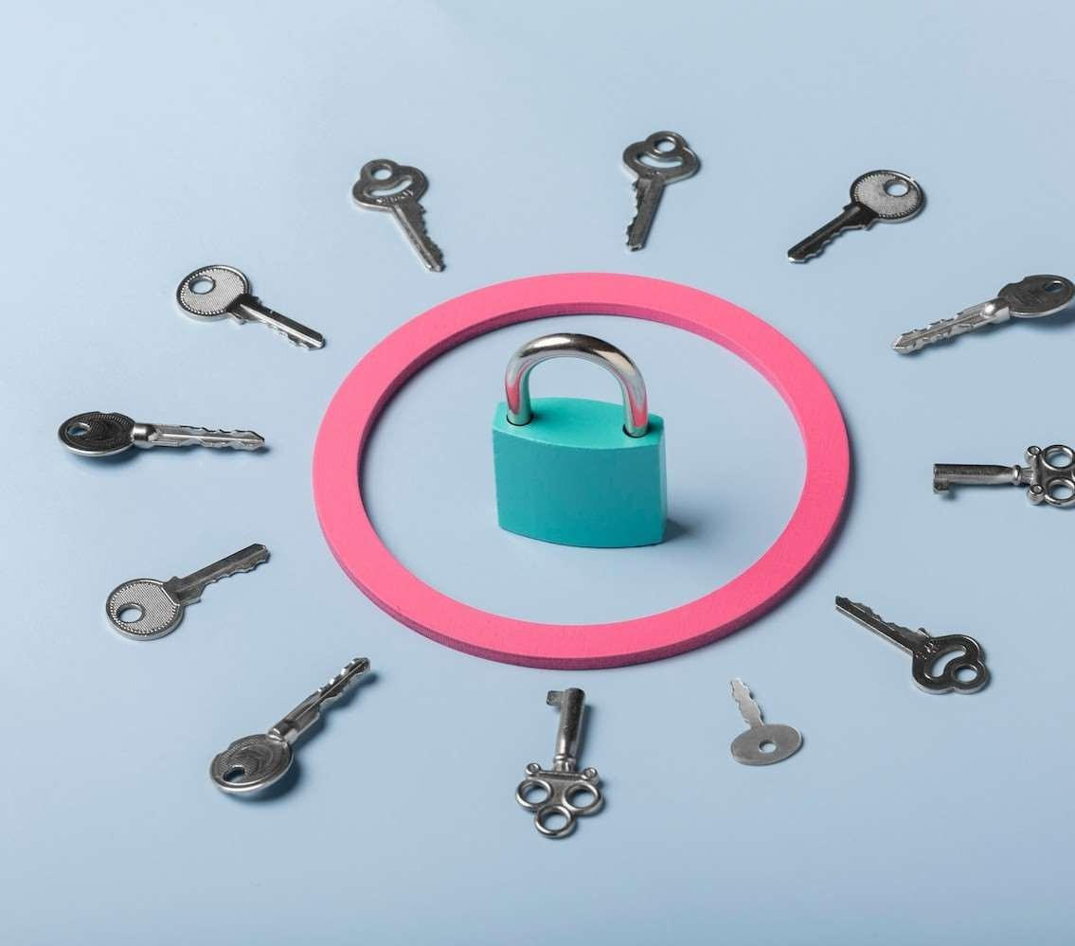





BEST PRACTICES FOR PASSWORD SECURITY
To maximize your password security, use
for each account,
enable
, and regularly update your passwords. A
can assist in maintaining these best practices effectively.

Slide 18




REAL-WORLD IMPACT
The use of
has been shown to significantly reduce the risk of
and .
Organizations and individuals alike benefit from enhanced
security and peace of mind in their online interactions.

Slide 19



CONCLUSION
In conclusion, and are powerful tools in the fight against cyber threats. By adopting these technologies, you can enhance your
, simplify your digital life, and protect
your sensitive information effectively.

Slide 20

Thanks!

